Slide 1
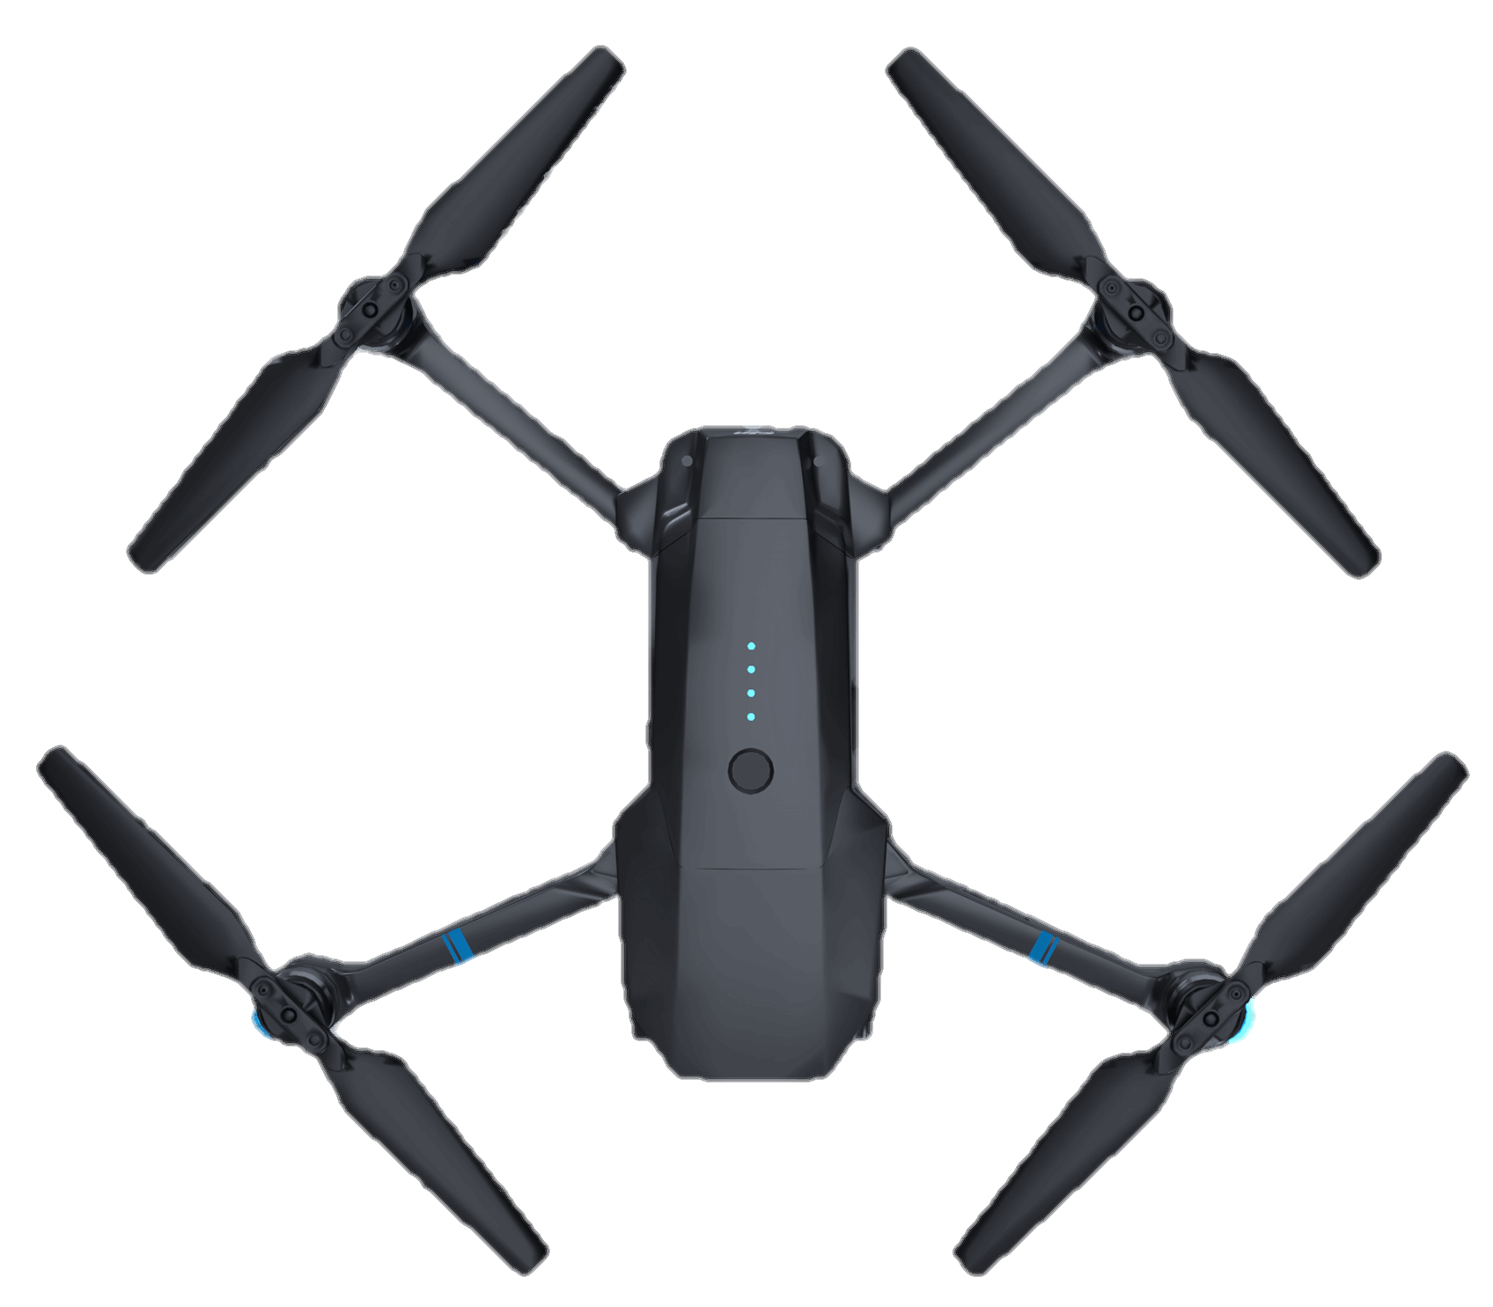
DRONES IN AEROCARE
[ GROUP G12~ ]
DRONES IN AEROCARE

Slide 2
1
K. Sai teja
2320030333
5
G. Likith
2320090069
S. Sandeep
2320030317
2
S. Hemanth
2320030462
3
4
Y. Hemanth
2320030468
DRONES IN AEROCARE

Slide 3
PROBLEM STATEMENT
Utilization Of Drones In Medical Sector For Emergency Rescues

Slide 4
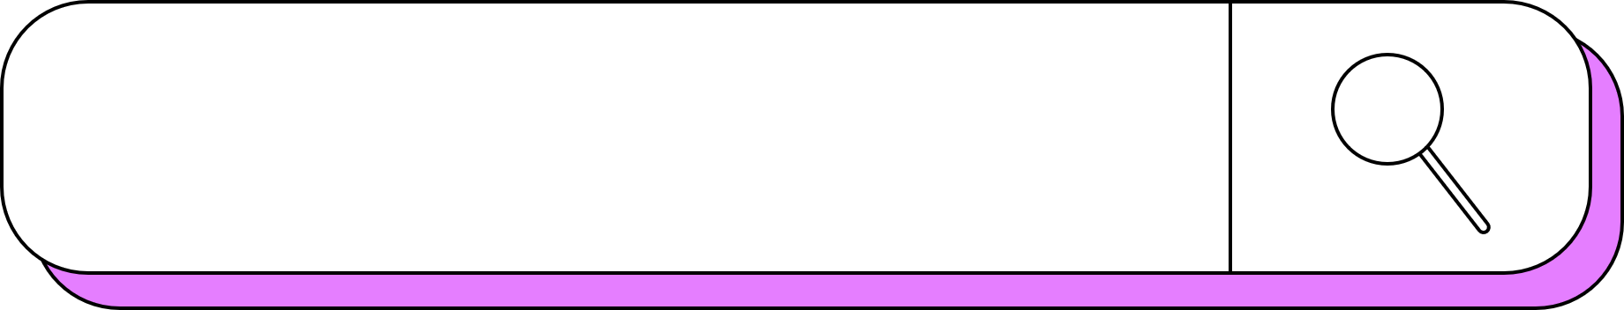
IDEATE
1O GM
1OO GM
Interactive flowcharts: These flowcharts can be used to map out the user's journey through a solution, allowing users to see how the different steps would work together.
Prototypes in PowerPoint or Keynote: These prototypes can be used to create a more polished presentation of the solution, allowing users to see how it would look and feel.
A sketch of a new phishing awareness training module
A paper prototype for our solution
A role-playing scenario for individual team members

Slide 5
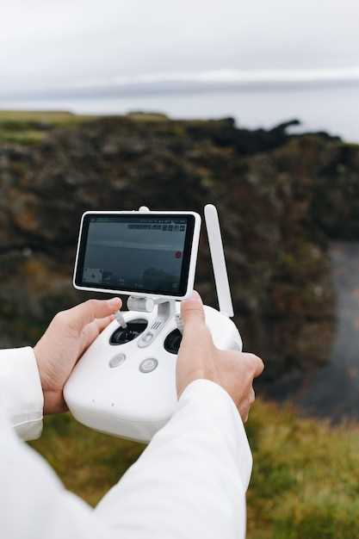

IDEAS
EMERGENCY RESPONSES: Equipping drones with first aid kits and defibrillators enables rapid response in emergencies, reaching accident sites or remote locations quickly, providing immediate medical assistance.
MEDICAL DELIVERY SUPPLIES: Drones swiftly transport critical medical supplies, including vaccines, blood samples, and organs, to remote or inaccessible areas during emergencies, ensuring timely healthcare access.
MOBILE BLOOD BANKS
MEDICAL SAMPLE TRANSPORT: Drones expedite safe transport of medical samples between facilities, minimizing transportation time and contamination risks, ensuring quicker analysis for improved healthcare efficiency.

Slide 6
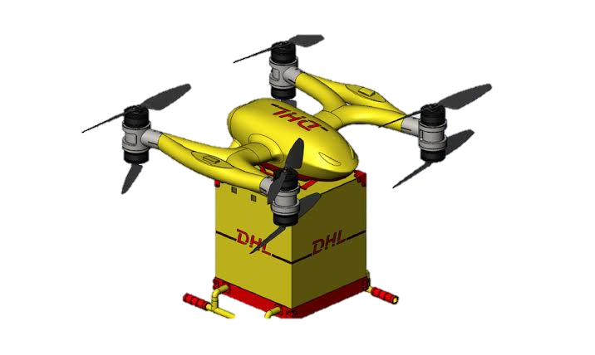
USER FEEDBACK
Gathering user feedback on a rough prototype of our medical drone is crucial to identify potential issues, improve the user experience, and ensure the technology

Slide 7
LEAN CANVAS MODEL
 |  | Designed for: |  |  |  |  | Designed by: |  | Date: |  | Version:
Lean Canvas |  | MEDICAL SUPPLY |  |  |  |  | SAI TEJA CHOWDARY |  | 5/12/2023
Problem | Solution |  | Unique Value Proposition |  |  | Unfair Advantage |  |  | Customer Segments
DUE TO LATE SUPPLY OF MEDICINES PATIENT LIFE MAY GET IN DANGER | 1.USAGE OF DRONES IN MEDICINES SUPPLY THE TIME CONSUMPTION WILL BE LESS |  | AFFORING FAST ,SAFE AND SECURE DELIVERY OF MEDICINES TO A REMOTE LOCATION |  |  |  | 1.EXPERT TEAM 2. PARTNERSHIPS 3.PATENTS |  | BY PROVIDING FAST AND SECURE DELIVERY OF MEDICINES OR BLOOD ON TIME .
Existing Alternatives | Key Metrics |  | High-Level Concept |  |  |  | Channels |  | Early Adopters
BY USING ZIPLINE BY USING HELICOPTERS | 1.Return of investment( ROI) 2.Brand awareness 3.Converstion Rate |  | SAVING PATIENTS FROM DANGEROUS AND LIFE THRETENING SITUATIONS |  |  |  | ONLINE PLATFORMS: WEBSITES,BLOGS AND SOCIAL MEDIA CAN USED TO PROMOTE OUR PROJECT |  | HOSPITALS, BLOODBANK CENTERS,AND THIRD PARTY USERS
Cost Structure |  |  |  | Revenue Structure
 |  |  |  | 1.PARTNERSHIPS 2. ADVERTISEMENTS .

Slide 8
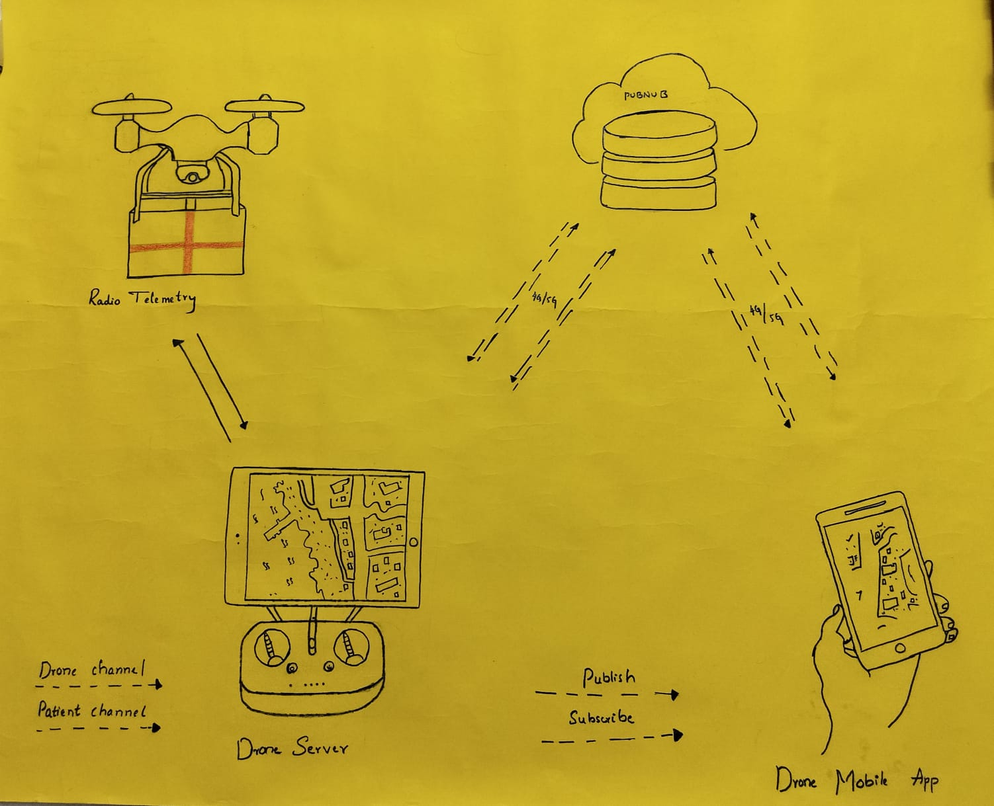
OUR VISION
Low-fidelity prototype Medical drones, equipped with advanced technology and sensors, revolutionize healthcare by swiftly transporting life-saving supplies such as medicines and blood samples to remote or disaster-stricken areas. These aerial vehicles enhance accessibility, reduce response times.
ROUGH PROTOTYPE

Slide 9
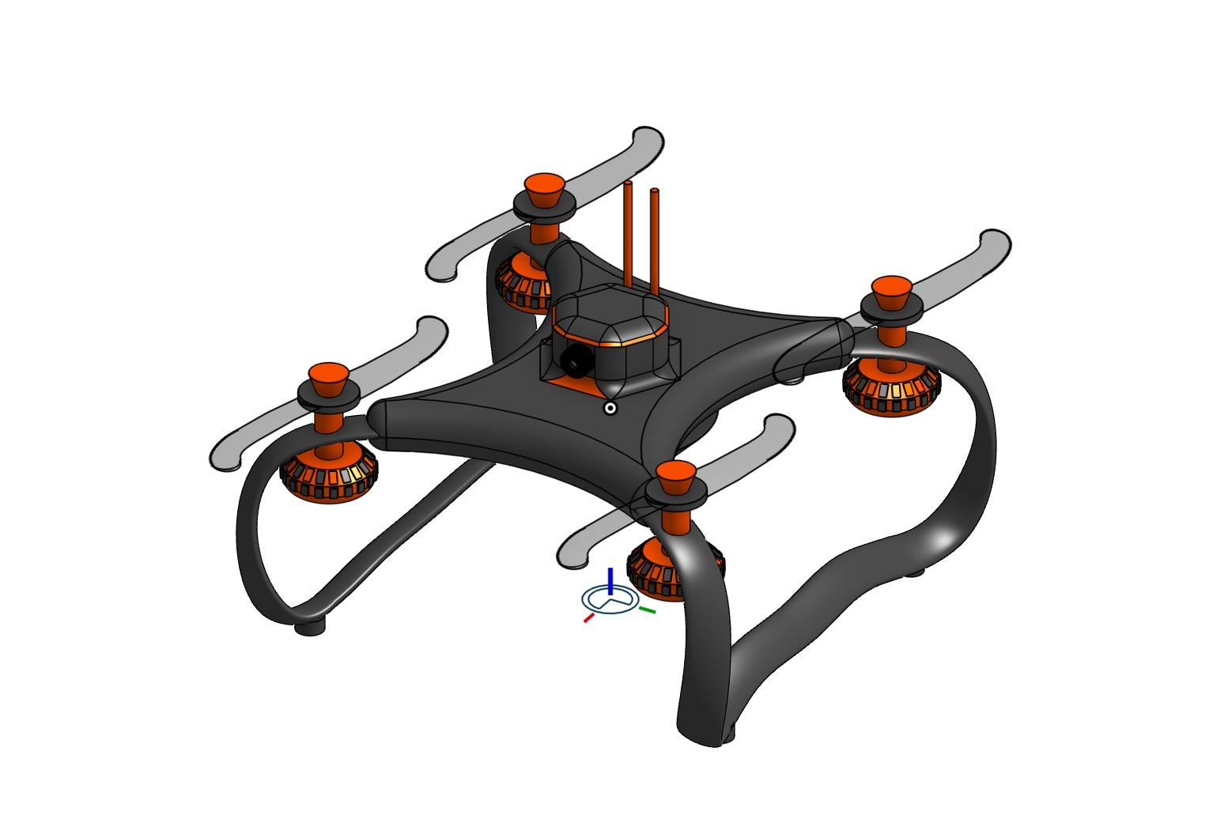
HIGH FIDELITY PROTOTYPE
High-fidelity prototype Medical drones, equipped with advanced technology and sensors.
3D MODEL
LINK:
https://cad.onshape.com/documents/3f6b181b984b58b9403c1753/w/f65a804b573600a22df02ce2/e/44a89a00a8cf83b19c48336e

Slide 10
FINANCIAL REQUIRMENTS
Total Estimated Seed Money: Rs. 40,00,000-10,700,000
10 KM RADIUS
20 KG LOAD CAPACITY
FOR APP DEVELOPMENT
1 KM RADIUS 1 KG LOAD CAPACITY
5 KM RADIUS 7 KG LOAD CAPACITY
Rs. 2 LAKHS
Rs. 15 LAKHS
Rs. 40 LAKHS
Rs. 50 LAKHS

Slide 11
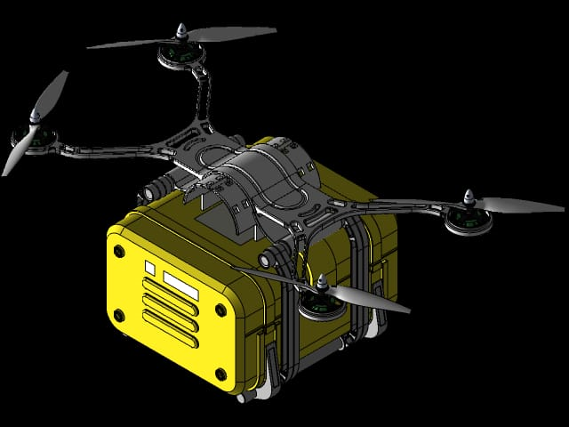
TESTING
Understanding the safety guidelines and regulations for operating drones.
DRONES IN AEROCARE
Testing a prototype involves evaluating its effectiveness in concepts. This process typically involves user testing, where individuals from the target audience interact with the prototype and provide feedback.

Slide 12
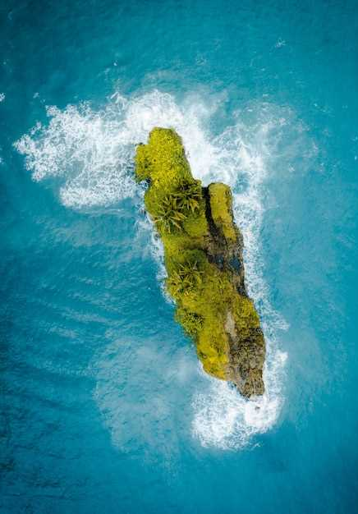
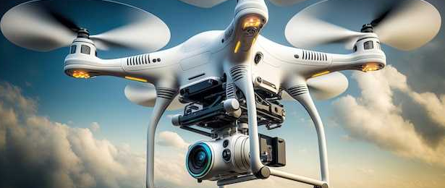
THANK YOU
WE HOPE YOU LIKE OUR PRESENTATION

